Slide 1
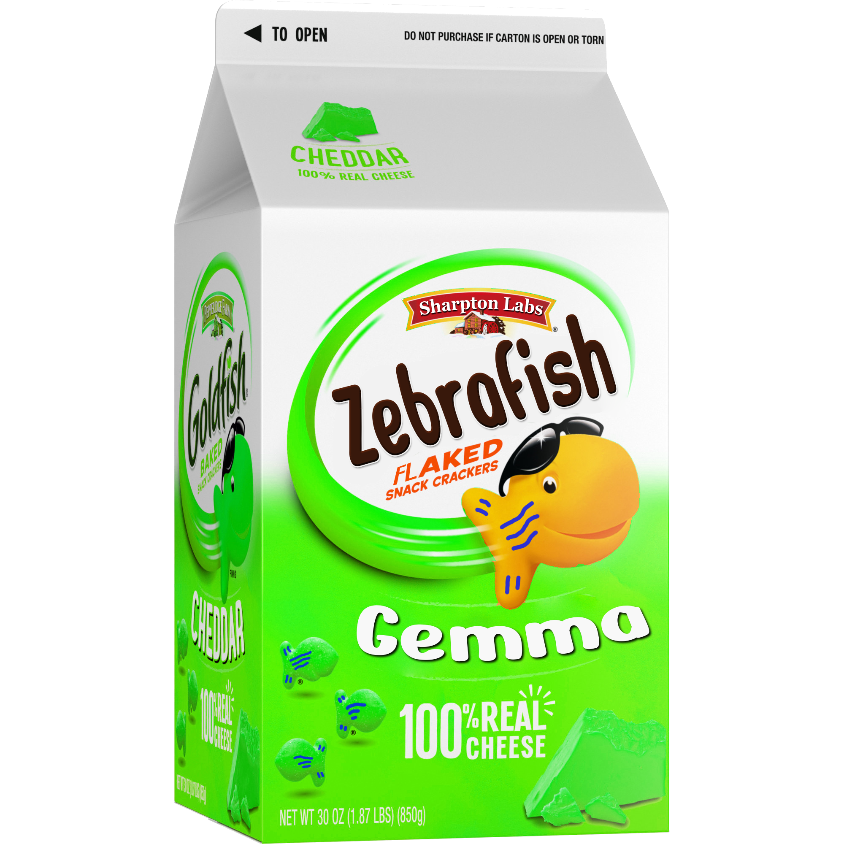
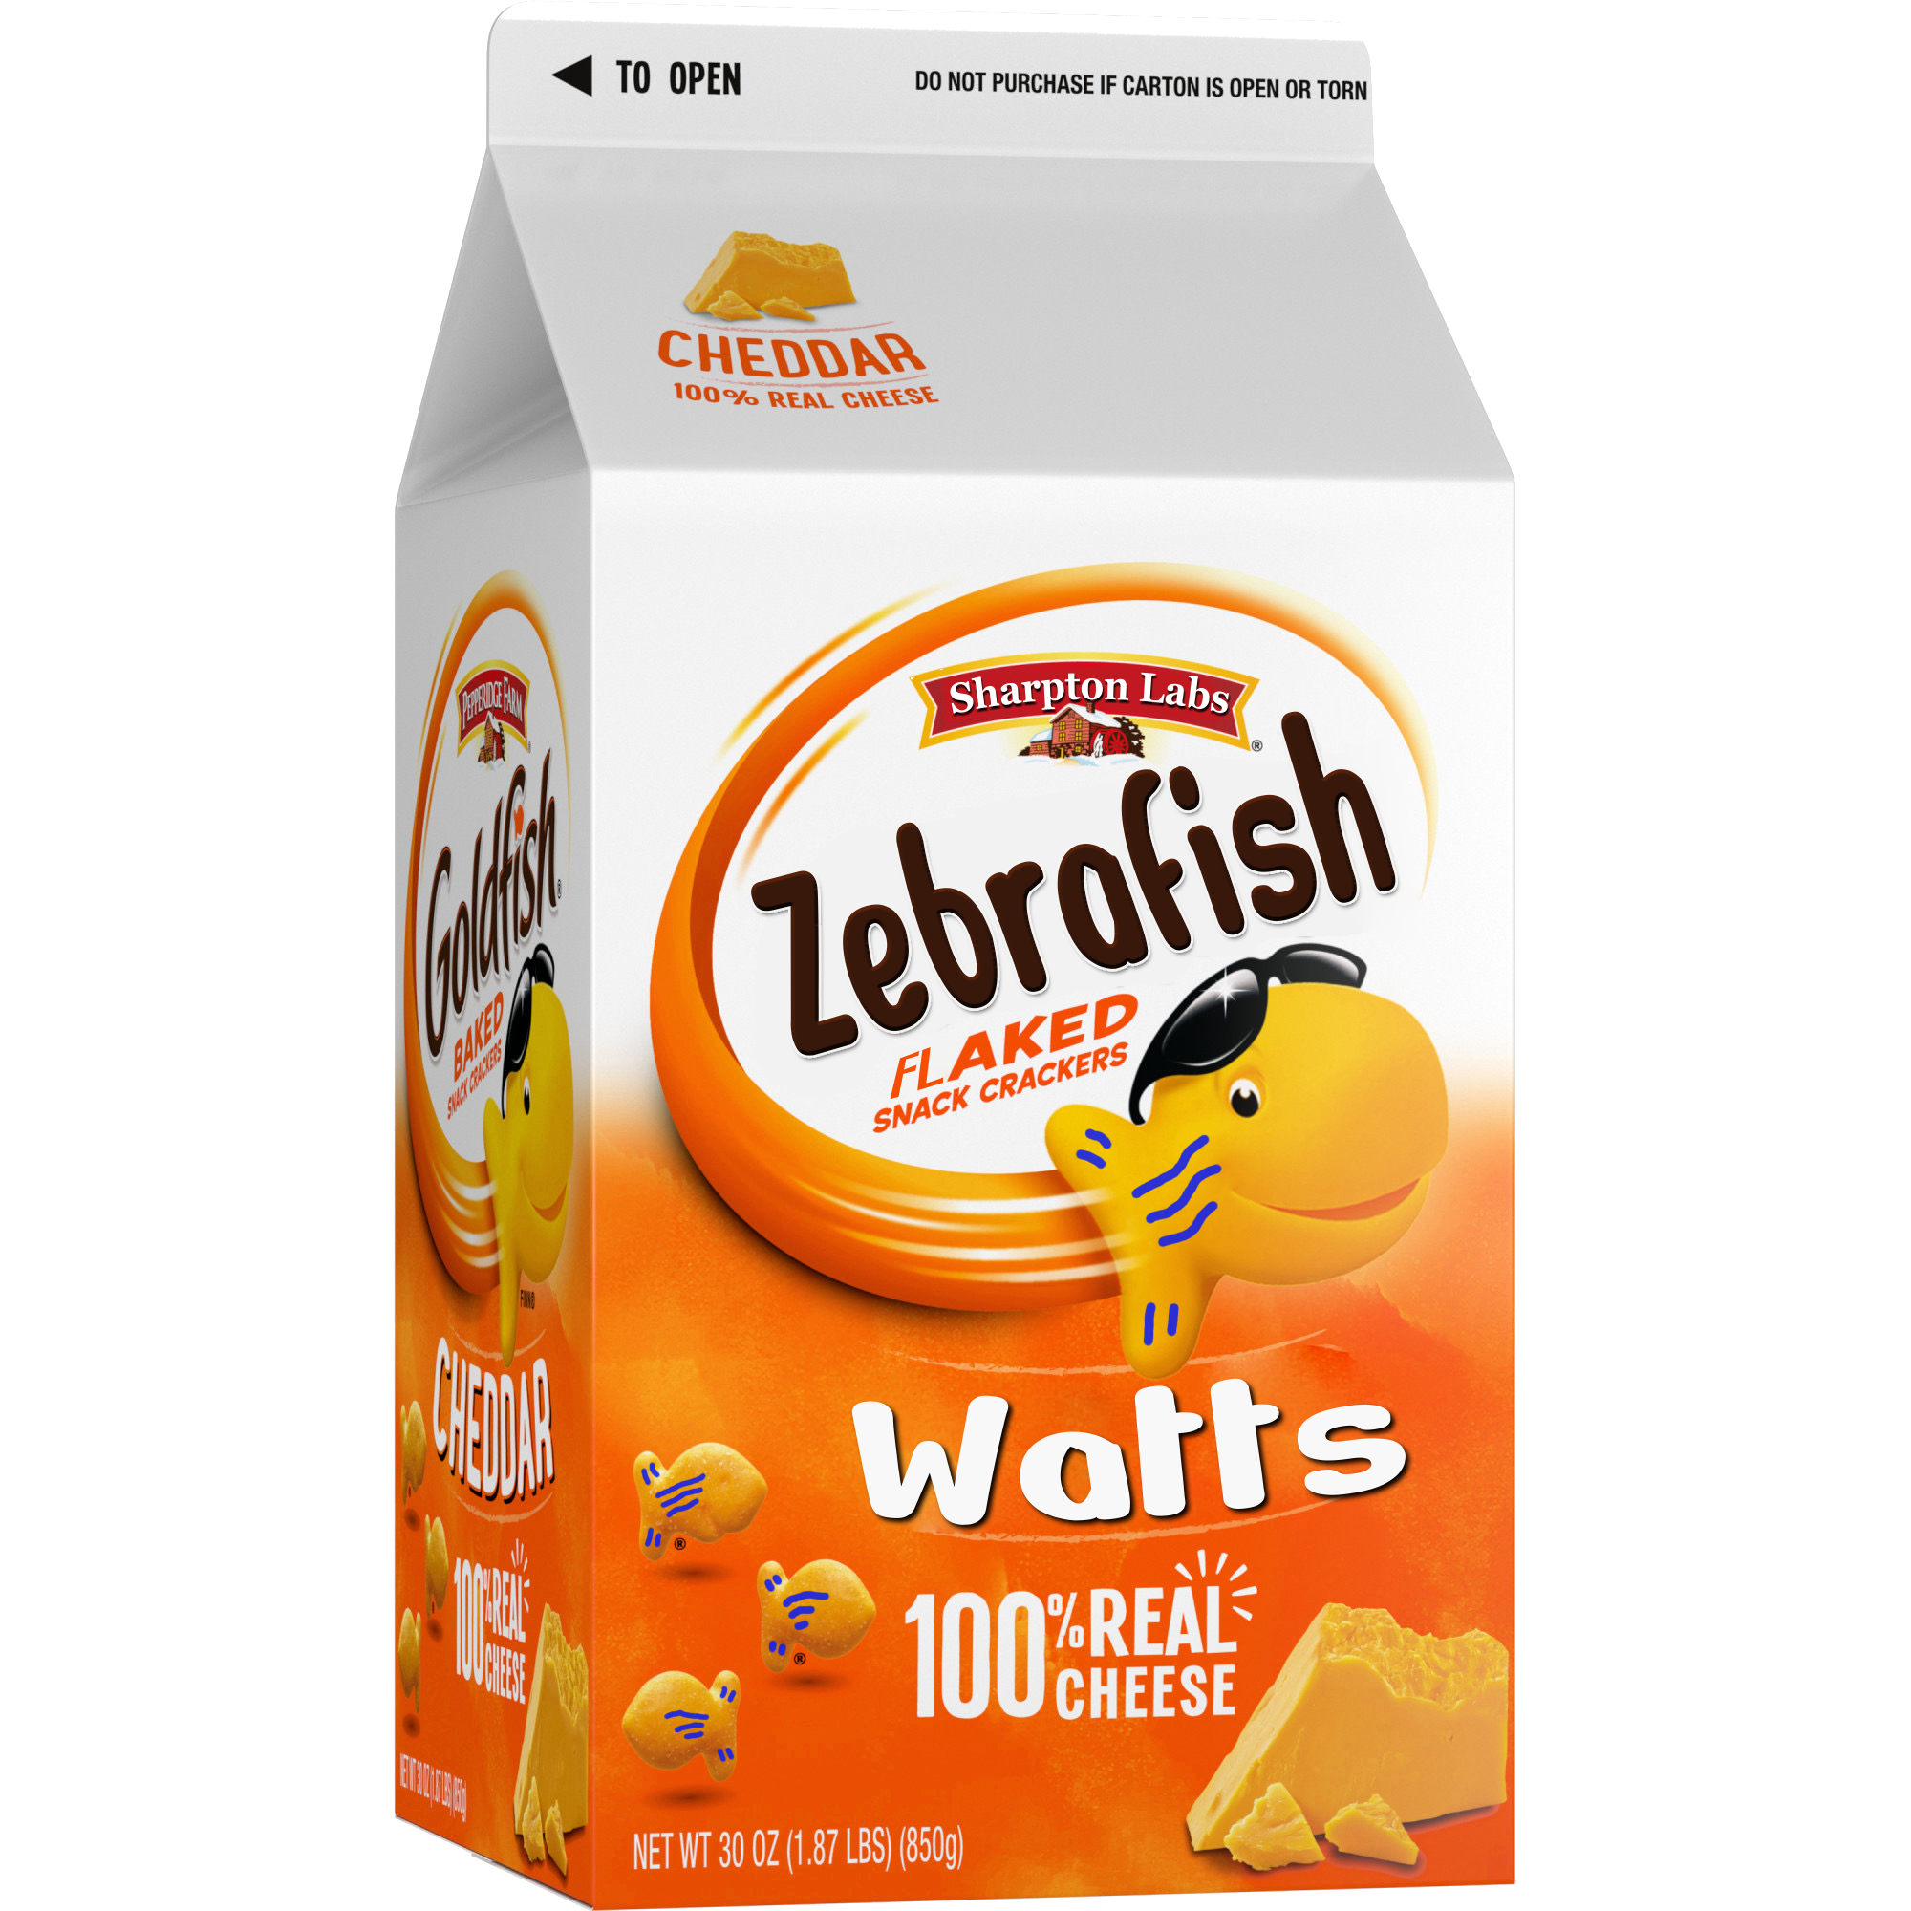
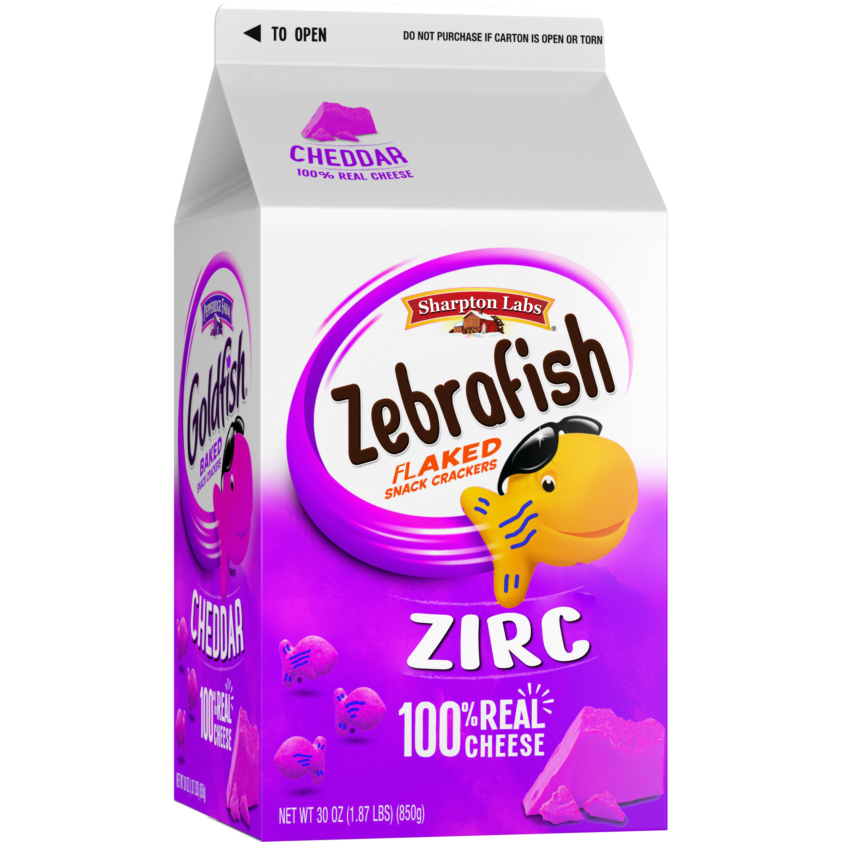

Diet and pathogen exposure differentially impact zebrafish gut microbiome and physiology
Michael Sieler
Sharpton Lab
Rules of Life Meeting
March 3rd, 2022
Notes:
Hello everyone. Today I will be presenting some updates and in the interest of time only key results of my analysis from a recent experiment that the Sharpton lab has completed.
This experiment investigated the effects of different diets and pathogen exposure on the physiology and gut microbiomes of zebrafish.

Slide 2
How do multiple exposure types impact host-associated microbiomes?
Notes:
Before I discuss the results of the experiment, I’d like to provide some context of for it.
[1] One of the major aims of the RoL project is to evaluate how a diversity of exposure types as well as their interaction impacts host-associated microbiomes. [2] The sharpton lab is focusing on the zebrafish arm of the study and before we conduct the large study shown here, we’ve been doing some smaller, preliminary experiments to hone in on appropriate dosages for antibiotics, temperature ranges and pathogen exposures for the big study.
[3] In this experiment that I’ll be talking about today, we focused on the pathogen arm indicated by purple arrow, dots and lines in the figure.
While I’m not sure if this experiment was specifically designed and executed with the larger RoL project in mind, I think you’ll find that the results of the experiment I’ll be talking about today provide additional motivation and support for the goals of what we’re all doing. Now I’d like to briefly introduce the zebrafish model system, since I suspect that many of you may or may not be too familiar with it and its relevance as a model study organism.

Slide 3
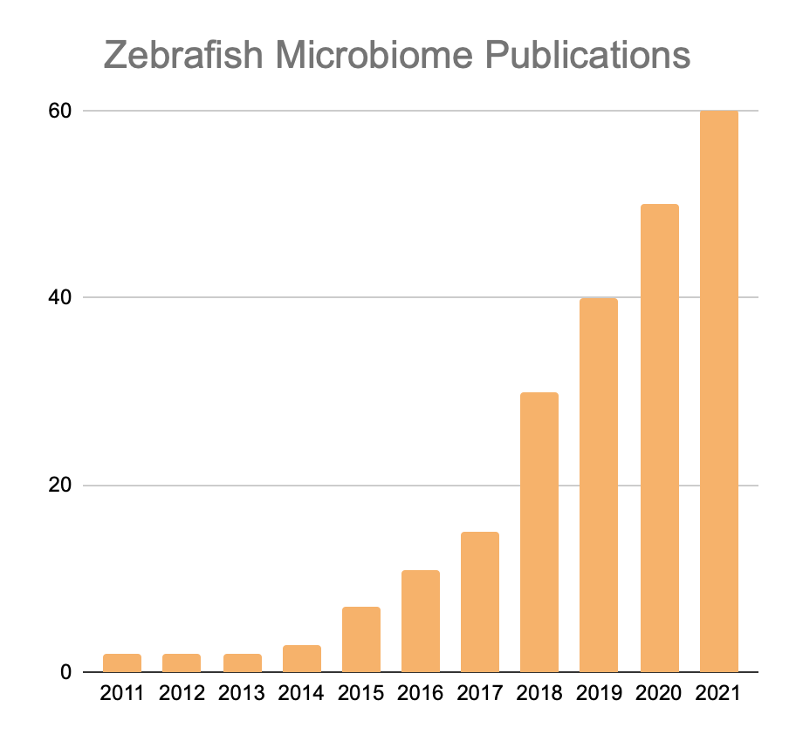
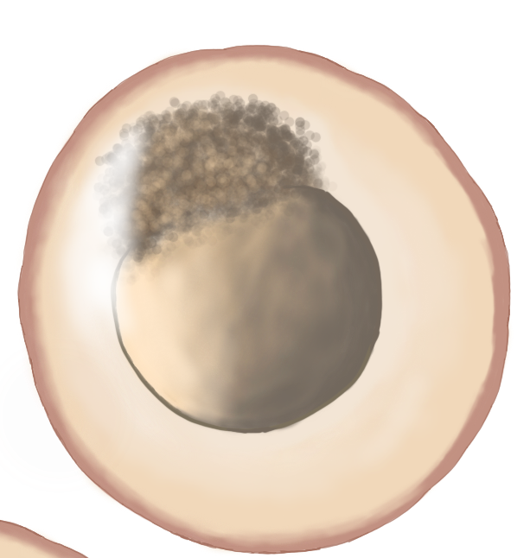
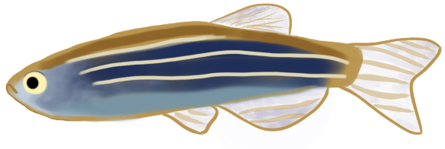
Zebrafish are an emerging fundamental microbiome research model
Benefits of using zebrafish:
Extensive homology to early human development, genetics, and biochemistry
Established, high-throughput methods
Large sample sizes
Ease of directly manipulate microbiome
Source: Web of Science
Notes:
Zebrafish are an emerging fundamental microbiome research model due to their long history as a model vertebrate organism...
[1] They have many benefits as a model system, to list a few:
-Extensive homology…
[2]-Established high-throughput methods…
[3]-Large sample sizes…
[4]-Ease of directly manipulating…
They also compliment coral and sea-grass as an aquatic organism.

Slide 4
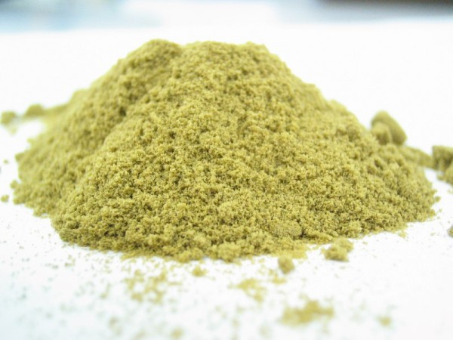
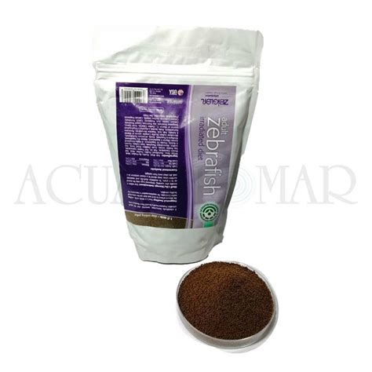
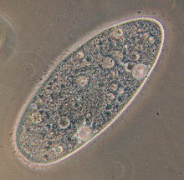
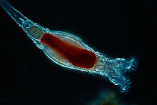
No standard reference diet currently exists for zebrafish studies
Zebrafish studies do not have a standard reference diet
Zebrafish diets contain varying macro- and micro-nutrient profiles
Mice have had a standard diet for nearly 40 years
Notes:
Despite their long established importance as a model organism and their increasing use in microbiome targeted studies, there still remains some key gaps in knowledge about them compared to other model systems like mice. [1] One of these gaps and main motivations for the study we conducted is that currently there is no standard reference diet used in zebrafish studies.
Standard reference diets are defined diets that contain consistent ingredients and nutrient compositions to allow for cross-comparisons of lab results.
[2] Instead, a variety of diets are used across zebrafish studies that include live feed and a mixture of defined/undefined ingredients.
These diets can vary widely in terms of ingredients, quality and of composition of macro- and micro-nutrient profiles.
[3] This is in stark contrast to other study organisms, such as mice, who have had a standard refence diet since 1980
{T} Given what we know about the influence diet has on host physiology and the microbiome’s important role in mediating host health, it raises important questions about whether or not we need to consider diet in microbiome-targeted zebrafish studies.
There has been some work in the zebrafish model that indicates that diet does matter…

Slide 5

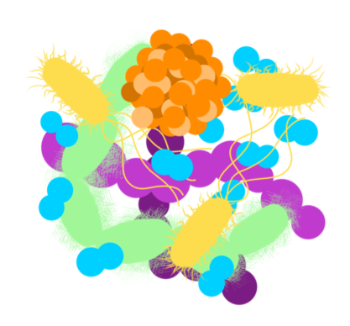


Unclear interaction effect of diet, the microbiome and pathogen exposure to influence zebrafish health
Notes:
There has been some work in the zebrafish model that indicates that diet does matter…
# DIET [1] Studies have shown that type of diet can impact growth, body condition and impair reproductive outcomes in juvenile to adult zebrafish
[2] Nutritional differences found across zebrafish diets can be responsible for undefined and uncontrolled variation in zebrafish studies.
{T} Some of these inconsistencies could be due to potential differences in how diets impact the development of zebrafish gut microbiomes
# MB [3] Prior research in zebrafish has shown that high and low fat diets can differentially affect microbiome development
As well as disrupt the microbiome in ways that impose negative health outcomes in the host
Similar results, investigating the role of high/low fat diets, have been found across other model systems and in humans
# PATHOGEN [4] Lastly, work investing pathogen exposure on Zebrafish health and microbiome find that parasite exposure and infection is linked to reduced weight, body condition scores, and reproductive outcomes.
As well as inflammation and dysbiosis of the gut microbiome
{T} However, there remains a gap in the literature about how diet, the microbiome and pathogen exposure interact to influence the health of the host.

Slide 6
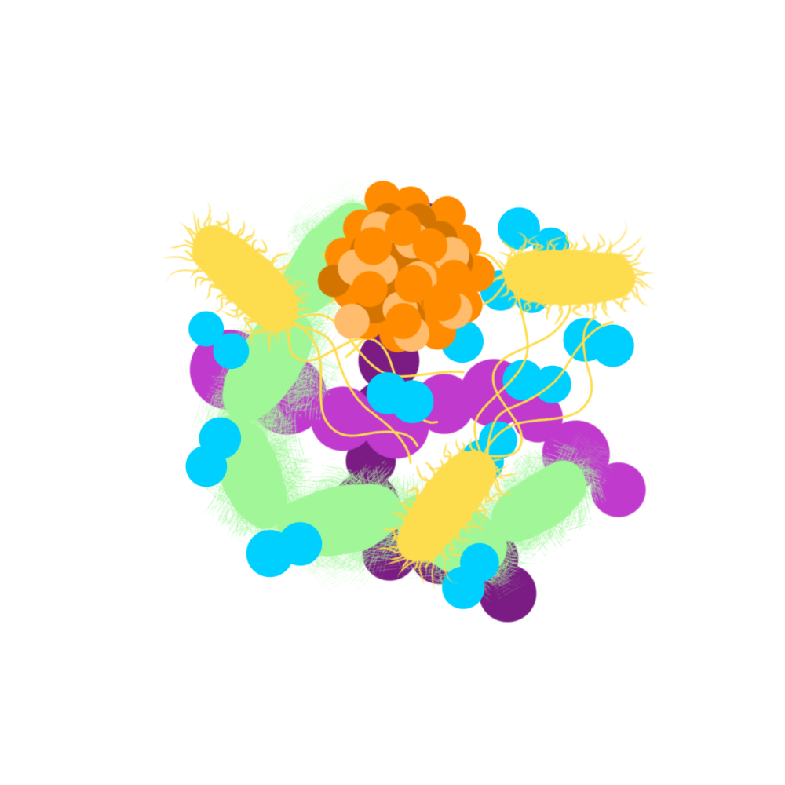

How do multiple exposure types impact the gut microbiome to influence the host’s health?
? Do the microbiomes of fish fed different commonly used laboratory diets differ?
? Do these interaction effects have a measurable effect on the host’s health?
? Diet dependent effects after pathogen exposure?
Notes:
So we sought to address these gaps in knowledge by asking the following questions:
Do the microbiomes of fish fed different commonly used laboratory diets differ?
Furthermore, do these differences manifest different microbiome outcomes following exposure to a pathogen?
Are these potential differences in the microbiome linked to the host’s health?
Answering these questions will clarify the role of diet on the zebrafish gut microbiome, but more broadly, it could lend support for our hypothesis that the state of the microbiome is influenced by the interaction of multiple factors.

Slide 7
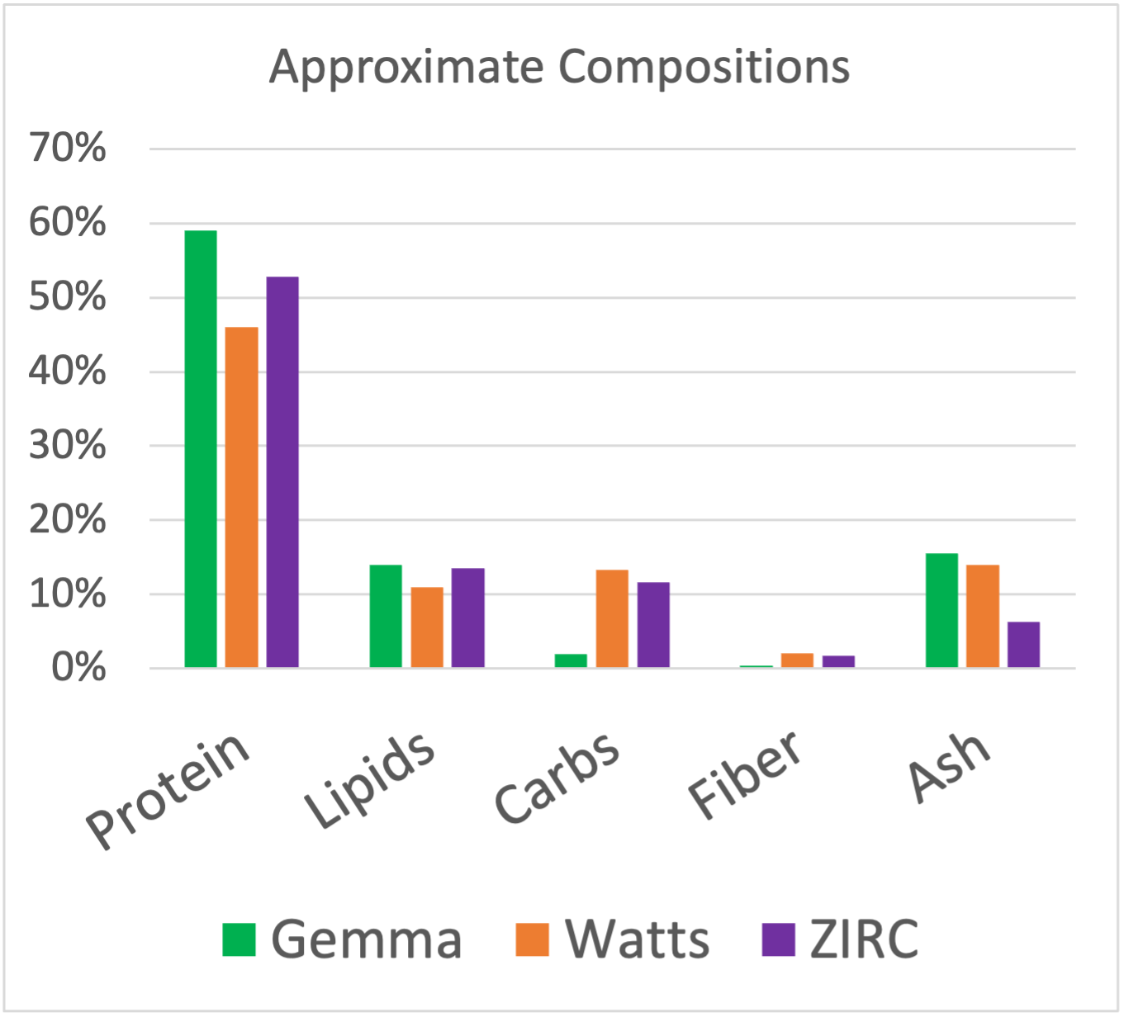
Common laboratory zebrafish diets
Gemma
Skretting Inc., commercial
Watts
Defined, laboratory
ZIRC
Mixture of diets
Zeigler, Spirulina, Golden Pearl
These diets are more consistent to one another than diets of previous studies
Notes:
For this study we used three commonly used zebrafish laboratory diets: Gemma, Watts and ZIRC.
- Gemma
- Watts
- ZIRC
[1] It’s important to note that while each of these diets have slightly different nutrient profiles to each other, they are far more consistent in composition to one another than the diets used in the previously mentioned analyses conducted around diet and the microbiome. Where those previous studies tested more extreme ranges, looking at how extreme ranges of high and low-fat diets influence the microbiome of zebrafish. Here, our study differs in that the three diets used are more consistent to one another, which if we see differences would highlight the importance of minor nutritional differences ability to affect the microbiome and health of zebrafish.
-------
Aquamax Grower 400® (45% protein, 16% fat, and 3% fiber,
Cyclop-eeze® (60% protein, 31% fat, and 0.5% fiber,
Nutrafin Max Flake Food® (44% protein, 5% fat, and 2% fiber,
TetraMin Tropical Flakes® (48% protein, 8% fat, and 2% fiber
Tetra Pond Koi Vibrance® (31% protein, 5% fat, and 2% fiber.
Diet A was formulated to contain 45.4% protein and 33.2% lipid,
Diet B contained 41.4% protein and 33.2% lipid.
-----

Slide 8
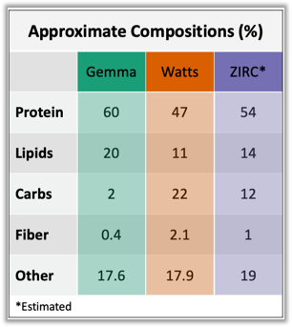
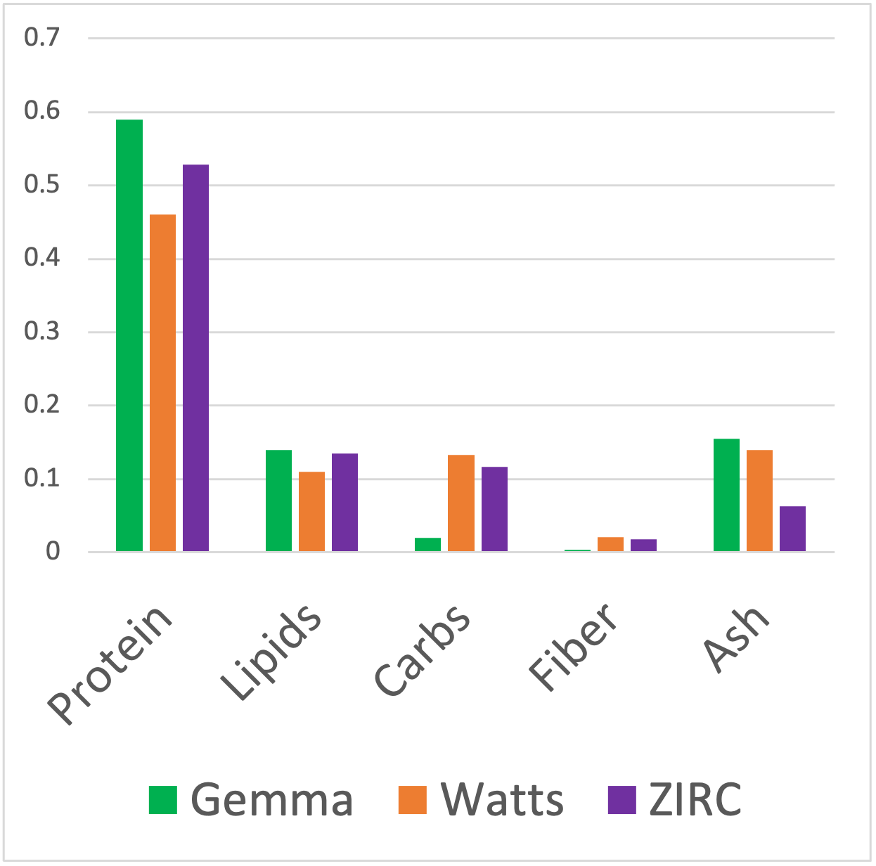

Slide 9
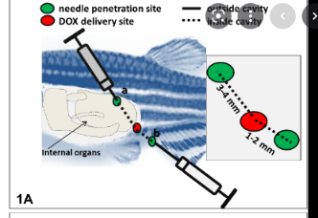
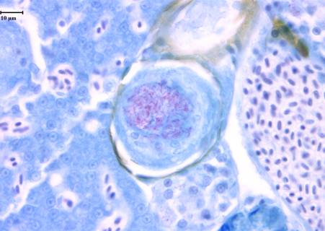
Mycobacterium chelonae is one of the most common zebrafish pathogens
Source of uncontrolled, inconsistency in results
Transmitted through diet
Injected fish with M. chelonae in coelomic cavity at 3mpf
Infection was assessed visually (presence/absence)
Notes:
Additionally, we wanted to test sensitivity of zebrafish gut microbiomes that were exposed to a pathogen, and see if there was an interaction between pathogen burden, diet and the microbiome.
We exposed a subset of fish to Mycobacterium chelonae, a common zebrafish pathogen, that is estimated to be present in 40% of zebrafish facilities.
[1] Source of uncontrolled, inconsistency in results
[2] The main route of transmission is hypothesized to be through diet, particularly live feeds commonly fed to larval and juvenile ZF
[3] Exposure to a pathogen through natural routes can be stochastic, so to ensure that our fish were exposed to mycobacterium we Injected the fish directly into the intestines, as shown in the figure on the top right.
[4] Infection status was assessed visually using acid fast stain of tissue samples

Slide 10

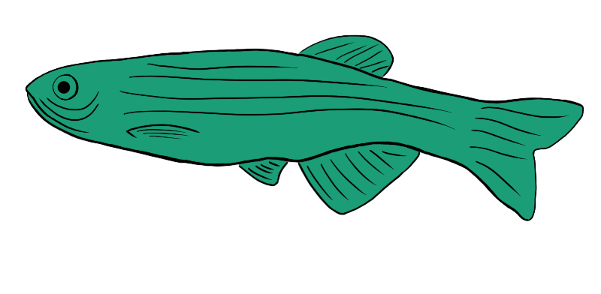
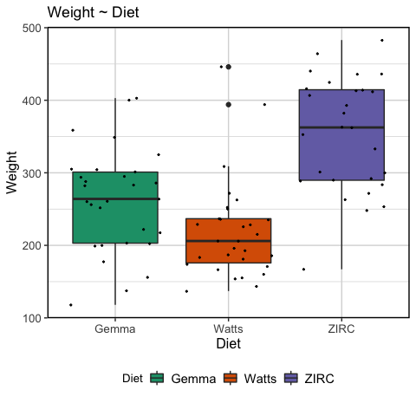
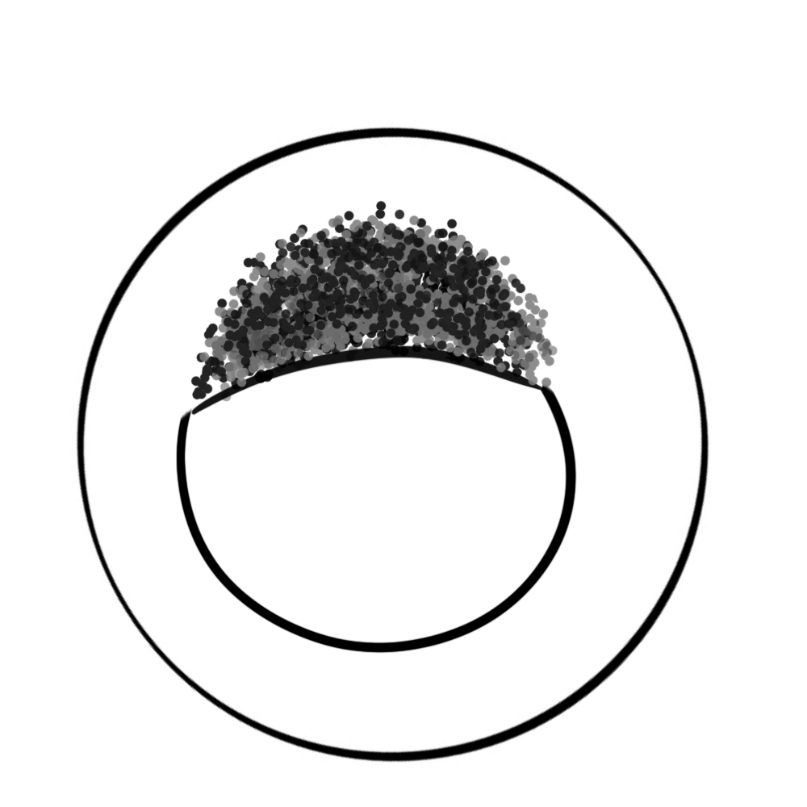

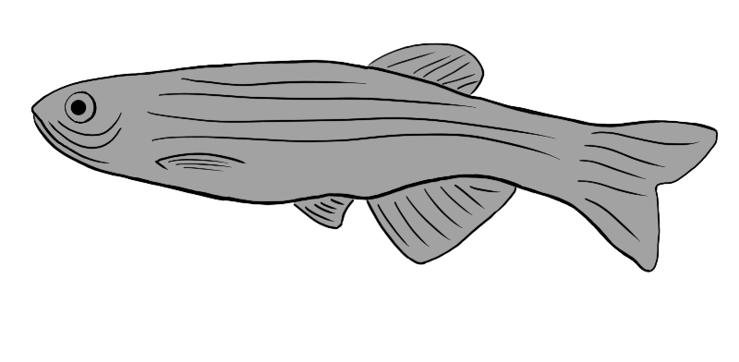
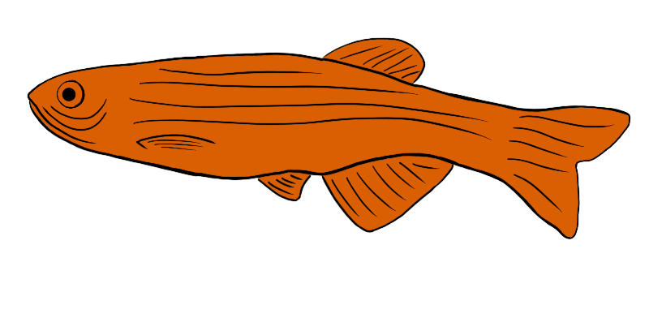
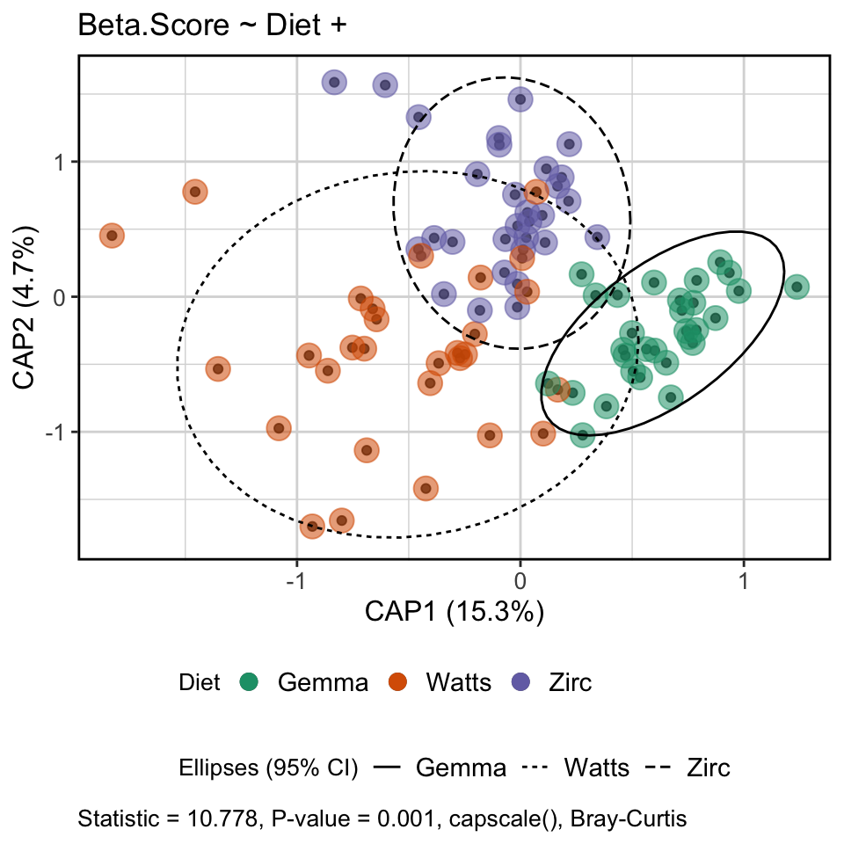
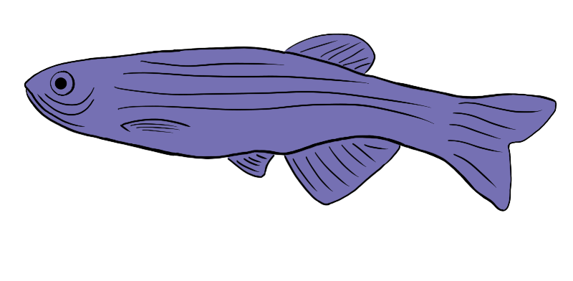
💩
Gemma
(n = ~60)
💩
(n = ~180)
Watts
(n = ~60)
💩
ZIRC
Fecal Sampling
(~3 & 6 mpf)
(n = ~60)
Pathogen
Exposure
(n=90)
💩
💩
Fed paramecia
(~10 – 30 dpf)
16S rDNA sequencing
Physiological & Microbiome analyses
Assigned diets (~1-6 mpf)
dpf = days post fertilization, mpf = months post fertilization
Notes:
Now, I’ll briefly walk you through the experiment and then discuss some key results
[1] For the first 30 days post fertilization (dpf), all fish were fed the same diet of paramecia
At 30 dpf, fish were assigned one of three diets.
[2] These diets included Gemma, Watts and ZIRC.
Each group of fish were fed these diets until the end of the experiment at 6 months of age
[3] At 3mpf, we collected our first round of fecal samples from fish and physiological measurements (such as weight, length and body condition score, BCS is considered an indicator of health in zebrafish)
[4] After taking fecal samples at 3mpf, fish in half of the tanks were exposed to the pathogen, Mycobacterium cholonae, while the other tanks acted as controls
[7] And then 6mpf we collected our final round of fecal samples and physiological data
[8] We then extracted the Microbial DNA and submitted them for sequencing
[9] From there, I ran the data through a series of pipelines to analyze the physiology and microbiomes of these fish.

Slide 11
Weight and body condition score
Notes:
First I will discuss the results of the diet endpoint analyses looking at weight and body condition score

Slide 12
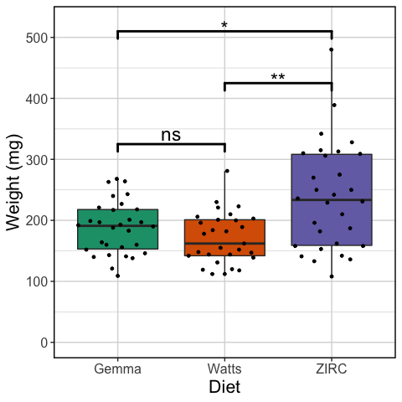
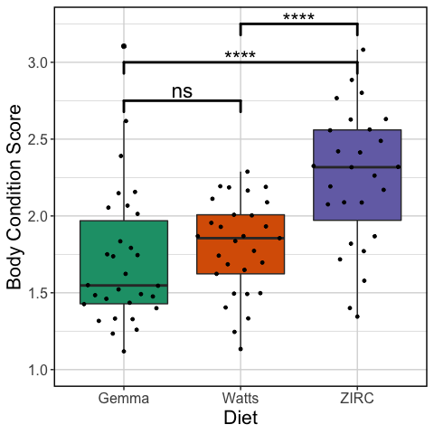
ZIRC fed fish tend to weigh more and have a higher body condition score
Body condition score (BCS) = (weight / length³ ) x 100
Notes:
Control, initial time point (3 months)

Slide 13
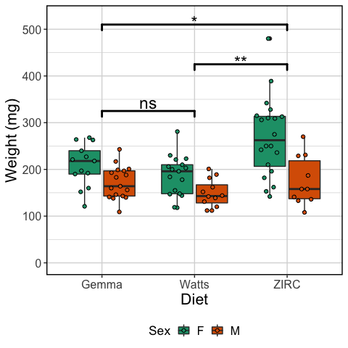
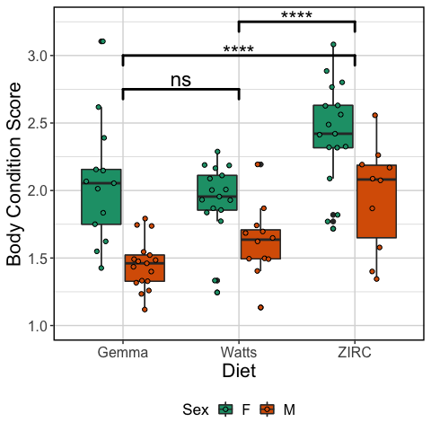

Slide 14
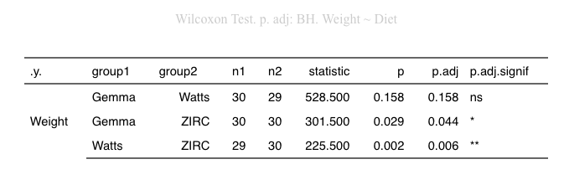
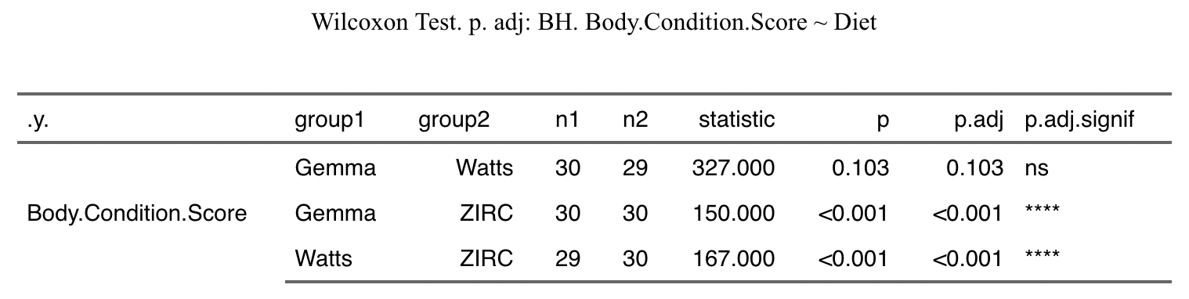

Slide 15
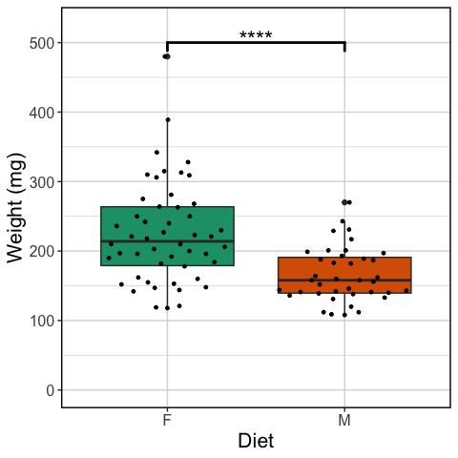
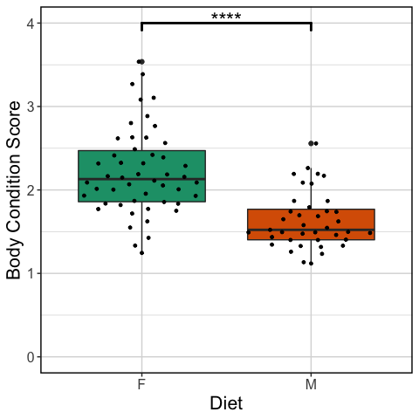
Sex differences in weight and body condition score of 3mo control fish
Body condition score (BCS) = (weight / length³ ) x 100

Slide 16
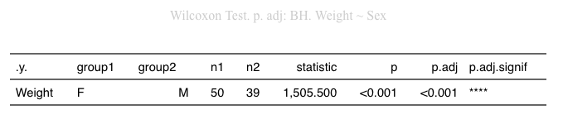
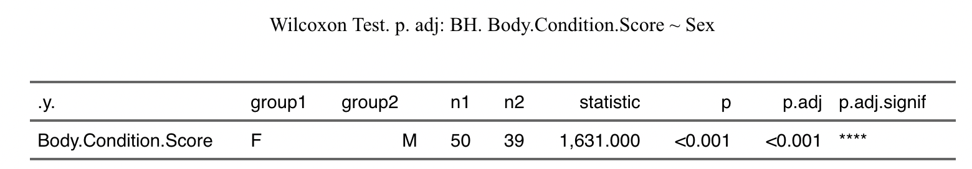

Slide 17
Is the microbiome intertwined with these diet by endpoint associations?
Diversity
How many unique taxa are found?
Composition
How similar are the types of microbes that comprise microbiome communities between hosts?
Abundance
Are some taxa found more abundantly in one treatment group compared to another?
Notes:
Next I investigated whether or not the the microbiome is intertwined with these diets
To do that, I measured:
[1] Diversity…
[2] Composition…
[3] Abundance…

Slide 18
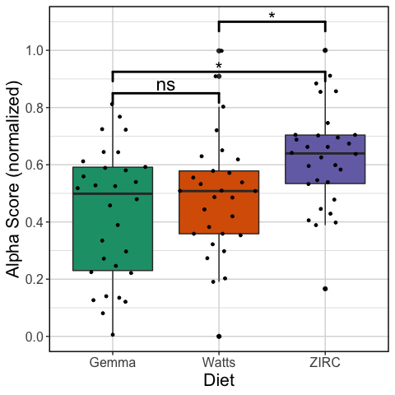
Watts fed fish have fewer taxa in their gut microbiomes
Shannon
Notes:
Shannon

Slide 19
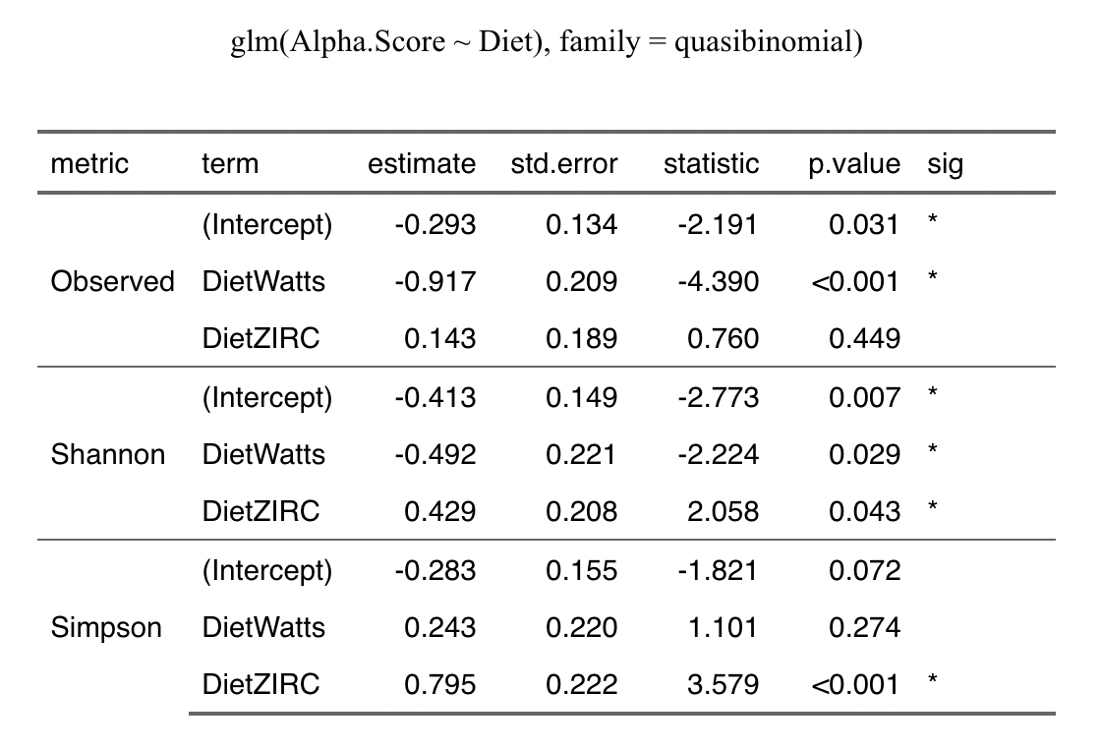
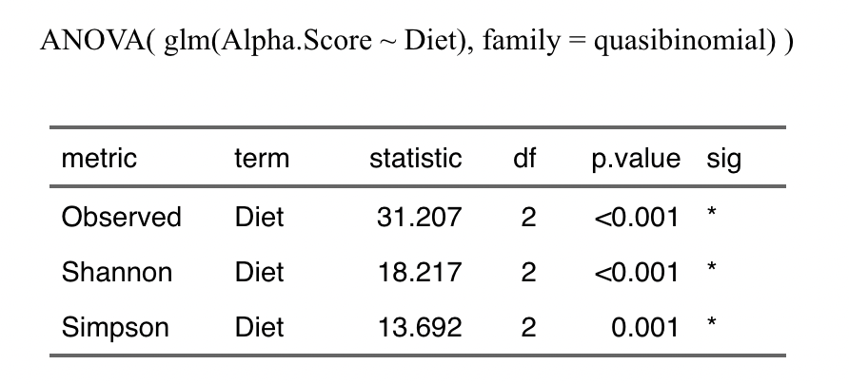

Slide 20
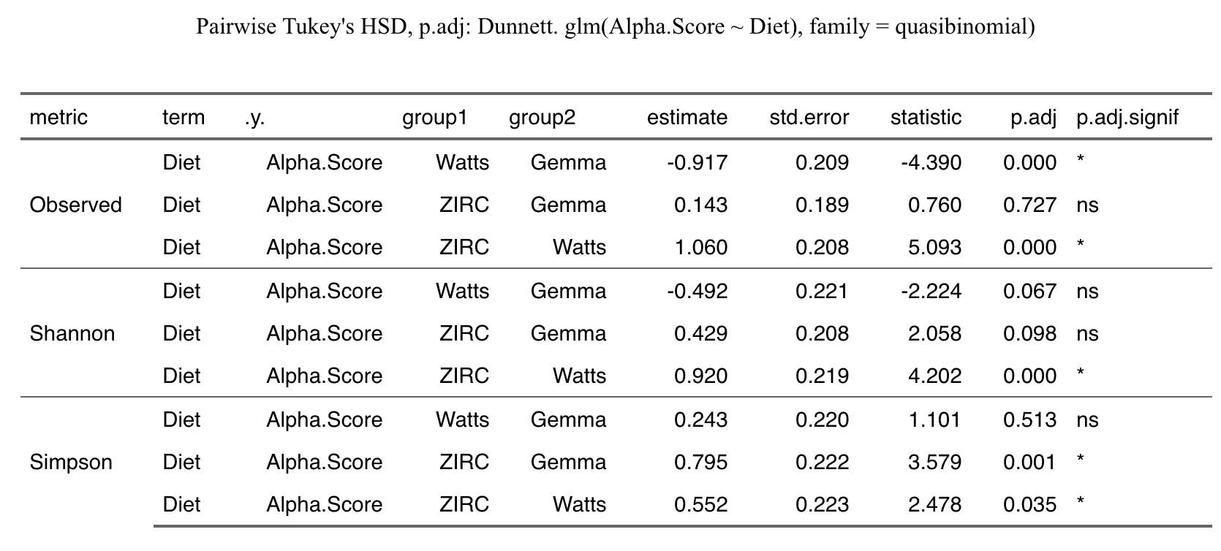

Slide 21
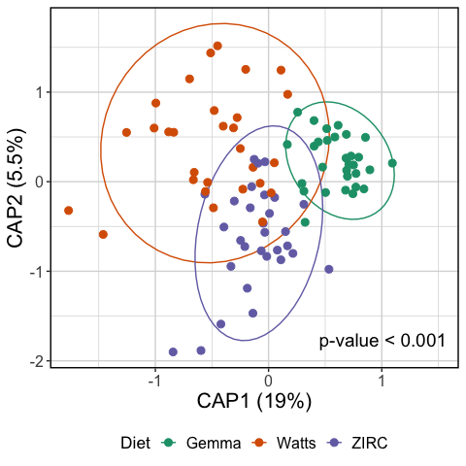
Fish fed the same diet tend to have similar microbiome compositions than to other diets
Bray-Curtis
Notes:
Bray-curtis
---- Fish fed the same diet have similar microbiomes to one another, and differ from fish fed a different diet. This can be seen by the clustering of similarly colored points to one another.
However, I noticed that the microbiome composition of fish fed the Watts diets are less consistent, as seen by the lack of clustering and spread of dots throughout the ordination plot.
Conversely, we see tight clustering of dots in the ZIRC and Gemma diets indicates more consistency of microbiome composition within those diets. A homogeneity of dispersion test showed was significant indicating that the variation in each of the diets is different from one another.
---
To assess differences in microbiome composition between samples (beta-diversity), I generated distance matrices for all samples using three different distance metrics: Bray-Curtis, Canberra, Sørensen. For simplicity I’ll only show Bray-Curtis, unless another metric differs from it. Using these distance matrices, I built full dbRDA (distance based redundancy analysis) models (function `capscale` from the `vegan` package) and then assessed significance with `anova.cca` (a PERMANOVA model; `vegan` package). I created ordinations based off of the various distance metrics we used (function `get.biplot.data` from the `phyloseqCompanion` and `ggplot` (`ggplot2` package)).

Slide 22
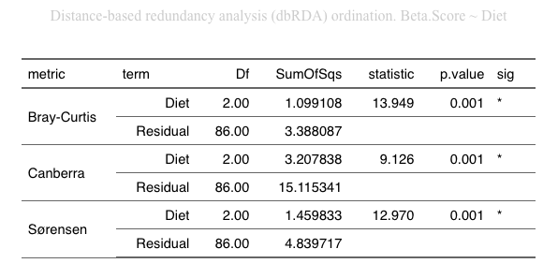

Slide 23
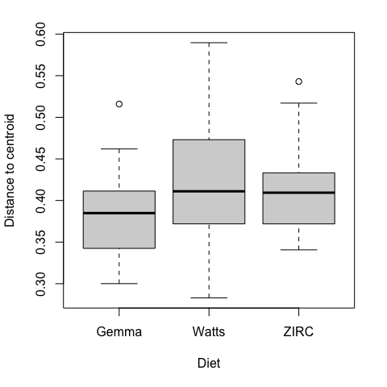
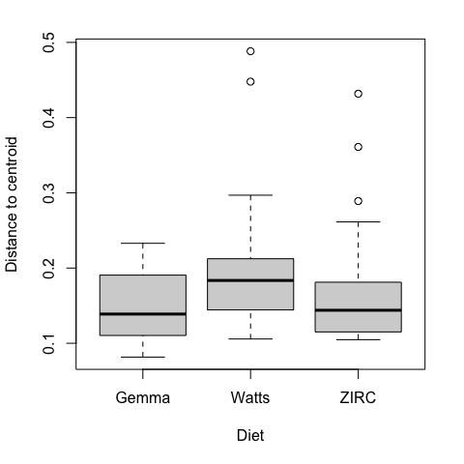
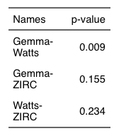
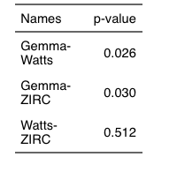
Canberra
Bray-Curtis

Slide 24
Development

Slide 25
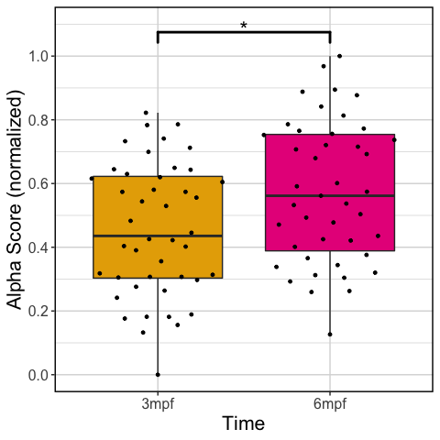
Alpha Diversity
Shannon
Notes:
Shannon

Slide 26
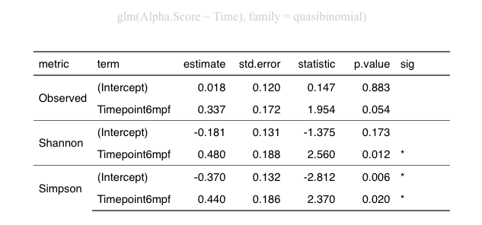
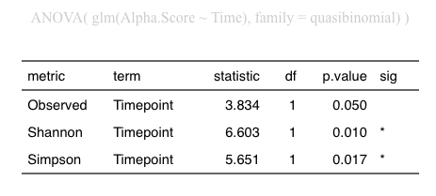
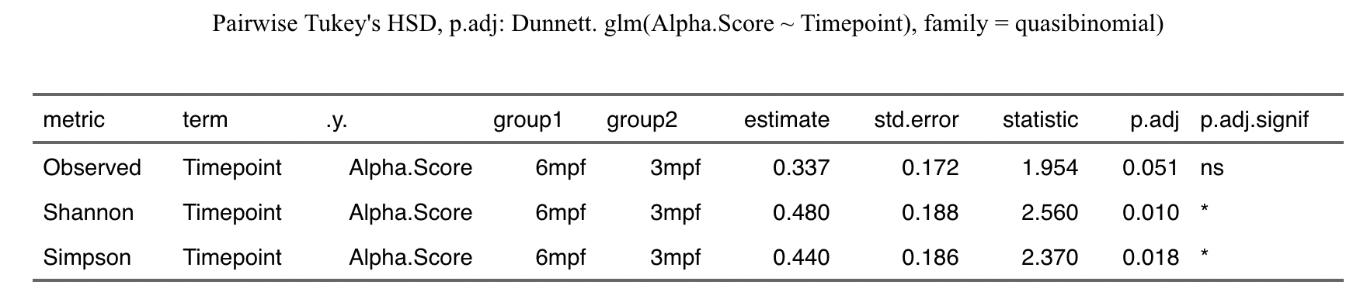

Slide 27
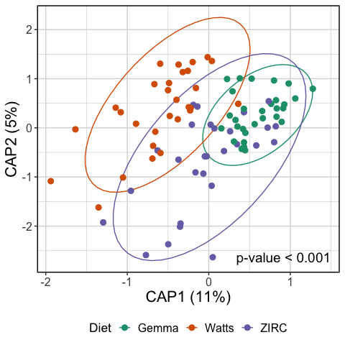
Beta Diversity
Notes:
Bray-curtis

Slide 28
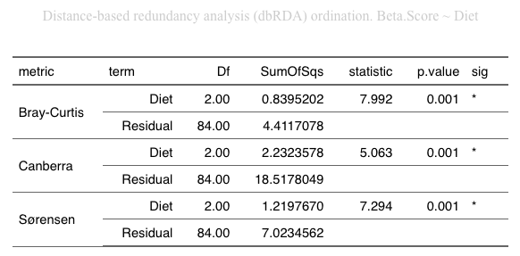

Slide 29


Slide 30



Slide 31
Development and Diet

Slide 32

Alpha Diversity
Shannon
Notes:
Shannon

Slide 33




Slide 34


Beta Diversity
Bray-Curtis
Canberra

Slide 35



Slide 36




Bray-Curtis
Canberra

Slide 37


Bray-Curtis
Canberra

Slide 38


Bray-Curtis
Canberra

Slide 39

Physiology did not differ significantly between time points within diets

Slide 40


Slide 41

Higher gut microbial diversity is linked to lower body condition score
Shannon
Notes:
Shannon

Slide 42

Notes:
Within ZIRC fed fish

Slide 43


Notes:
All diets & ZIRC fed fish

Slide 44

Differential abundance of genera at 6 months
Notes:
Compared to each diet’s 3 month samples

Slide 45



Differentially abundant genera at 6 months
Watts
ZIRC
Gemma

Slide 46
Could these differences in the microbiome affect how fish respond to pathogen exposure?
Notes:
Finally, I investigated the potential impact of diet on the microbiome of fish exposed to mycobacterium

Slide 47

Mycobacterium exposure may be limiting microbiome diversification
Shannon
Notes:
Shannon

Slide 48




Slide 49

ZIRC fed fish appear more sensitive to pathogen exposure
ns
ns
*
*
ns
*
ns
ns
ns
Shannon
Notes:
Shannon

Slide 50



Slide 51


Slide 52

Gut microbial composition at final time point between exposed an unexposed fish
Bray-Curtis

Slide 53


Slide 54

Gut microbial composition of diets at final time point between exposed an unexposed fish
Bray-Curtis

Slide 55


Slide 56




Bray-Curtis
Canberra

Slide 58

Log abundance of Mycobacterium genera

Slide 59



Slide 60



Slide 61
Diet differentially impacts physiology and gut microbiome development in zebrafish
Main observations:
ZIRC heavier compared to Watts and Gemma
Gemma and ZIRC had higher diversity of taxa to Watts
Fish fed the same diet have similar microbiome compositions
Watts have less consistent microbiome communities compared to Gemma and ZIRC
ZIRC fed fish’s body condition score is linked to microbiome
Exposed ZIRC fish have lower microbiome diversity
Together, these results demonstrate that diet and host health are intertwined with their microbiome’s development and sensitivity to pathogen exposure
Notes:
In summary, my main observations are:
[1]

Slide 62
Diet should be carefully considered in microbiome-targeted zebrafish studies
May be worth establishing a standard reference diet:
Improve understanding of zebrafish health and nutrition
Advance knowledge of how the diet and microbiome interact
Support reproducibility and interpretability of studies
Different diets may serve different roles
More variation could better mimic human populations
Less variation could minimize influence of diet on results
Challenges: development of a germ-free diet that is nutritionally equivalent
Notes:
Furthermore, our results suggest that researchers should carefully consider diet as a critical variable, especially studies considering the microbiome.
[1] It may even be important for the ZF microbiome research community to consider standard reference diets.
[A] This would aid in our understanding of what constitutes an “ideal” zebrafish diet for optimal health and nutrition
[B] advance our knowledge of how diet and the microbiome interact
[C] Support reproducibility and interpretability of results across, not only microbiome-targeted, but all studies involving zebrafish
[2] Our results also demonstrate that there may be situations where choosing a particular diet is more appropriate given the study's objectives. For example,
more Variation
Less variation
[3] Lastly, One challenge towards developing a standard reference diet for microbiome-targeted zebrafish studies, is its ability to be produced germ-free.
Prior research has shown that germ-free diets are often not nutritionally commiserate with conventional diets.
Although, there has been some significant progress on this front in recent years, but more research is needed to design optimal GF diets.

Slide 63
Future directions
Clarify how nutrient profile of diets associates with microbiome composition and health outcomes
Repeat experiment
Natural (oral) exposure
Immunologic endpoints
Other common pathogens
Investigate differentially abundant taxa
Notes:
[1] More research will be needed to clarify how nutrient profiles of commonly used laboratory diets influence microbiome composition and health outcomes in zebrafish.
[2] Repeat Experiment
[3] In this study the pathogen was introduced by injection into the coelomic intestinal cavity to ensure exposure. However, this is not the normal route of exposure. For this reason, we are interested in repeating this study using a more natural exposure
[4] Adding immunological endpoints to get a better understanding of the broader physiological impact of diet and pathogen exposure
[5] Explore other common zf pathogens
Pseudocapillaria nematode
Pseudoloma microsporidium
[6] Investigate further into the connection between differentially abundant taxa and the variation in microbiomes and health outcomes between the different diet

Slide 64
Acknowledgements
Sharpton Lab:
Dr. Thomas Sharpton
Dr. Kristin Kasschau
Dr. Keaton Stagaman
Kent Lab:
Dr. Mike Kent
Colleen Al-Samarrie
Dr. Corbin Schuster
ZIRC
Dr. Zoltan Varga
Funding source:
5R24OD010998 NIH ORIP Control and Impacts of Disease in Zebrafish Research Facilities. – Admin Suppl (Diet Studies)
NSF…
Notes:
Thank you to our funders, collaborators and everyone in the Sharpton and Kent lab who assisted me with this project.
In particular, I’d like to thank Colleen and Kristin who did the heavy lifting with fish husbandry, fecal collections and generating the 16S data.
I appreciate your time and attention, and If anyone has questions, please submit questions to the questionaire form

Slide 66




GEMMA
WATTS
ZIRC
Protein 59%;
Lipids 14%;
Fiber 0.2%;
Ash 14%;
Phosphorus 1.3%;
Calcium 1.5%;
Sodium 0.7%;
Vitamin A 23000 IU/kg; Vitamin D3 2800 IU/kg; Vitamin C 1000mg/kg; Vitamin E 400mg/kg.
(https://zebrafish.skrettingusa.com/pages/faq)
Adult
Juvenile

Slide 67
Major Feedback
Cut out infection status slides
Stick with exposure
Need to introduce the different “players” in the study
Each treatment type needs to be introduced with a separate slide
Types of diets, pathogen exposure
Introduce the importance of zebrafish in microbiome studies
Emerging model system
Introduce diets
What are their compositions
How do the previous diet studies compare to these diets? (lipid content)
Validate what the nutritional profiles are for each diet study
Introduce mycobacterium
How common?
Principle mechanism to assess impact of infection are through inter-peroitoneal injection
Reduce text
Better to illustrate (figure/diagram) take-aways than use text, but if text keep it succinct
Per slide, keep all full sentences or short statements. Don’t mix
Acknowledgements
Double check with collaborators that everyone who assisted is included
Funding sources are accurate

Slide 68
Minor Feedback
Test the differences of variation of each diet and compare to one another. Does ZIRC have more variation (aka less consistency) of body condition score?
If so add to slide looking at physiology by diet (box plots).
Link the inconsistency of across diets to the various analyses to bolster observations that these diets have different effects on the host.
Add page numbers
When discussing a particular taxa, stay high level but mention any interesting biological context/knowledge about it.
Prior study found…, this_taxa was linked to A and B, it suggests that this organism is intertwined with the outcomes of A in that experiment.
Even just an association, but if you can tie them to something relevant to what you observed in your experience that’s even better.

Slide 69
Knitpicks
Use ggbeeswarm instead of geom_jitter
Geom_beeswarm
Geom_quasirandom <- side by side points
Make points over box plots bigger
Ordination
Keep one dot, no inner/outer.
Color ellipses same color, remove linetype from legend
Make sure colors are consistent across plots and diagrams
Spell out abbreviations on figures (exp -> exposed)

Slide 70
Additional comments
Personal Question: No standard reference diet for Zebrafish this is important because the diet affects growth and physiology- Why is there not one for the model organisms that's been around for a while?
Note: IS, metabolism, and digestion are all impacted but not needed since the people are familiar with zebrafish and molecular biology?
Notes: Could slide 27-28 be combined and summarized ?
Question: Ask about slide 10 injection pathogens. Control was confusing.
Personal Question: Could you talk about what diet was made of? Is one high fat or low fat, a thing I did not understand. I am unfamiliar with the types. Is Zirc, Watts, or Gemma one particular or the other?
Personal Questions: As a model organism is the diet similarity good or bad between fish. Is this only important for the purpose of individual study? Is this the list of names is for?
Diet differential slide has a lot of text to follow. No page number.
Question: Would a germ free diet have a negative effect on physiology? Like it does germ free mice.

Slide 71

Diet can influence zebrafish physiology
Notes:
[1] Studies have shown that type of diet can impact growth, body condition and impair reproductive outcomes in juvenile to adult zebrafish
[2] Nutritional differences found across zebrafish diets can be responsible for undefined and uncontrolled variation in zebrafish studies.
{T} Some of these inconsistencies could be due to potential differences in how the diets impact the development of zebrafish gut microbiomes
-------
Aquamax Grower 400® (45% protein, 16% fat, and 3% fiber,
Cyclop-eeze® (60% protein, 31% fat, and 0.5% fiber,
Nutrafin Max Flake Food® (44% protein, 5% fat, and 2% fiber,
TetraMin Tropical Flakes® (48% protein, 8% fat, and 2% fiber
Tetra Pond Koi Vibrance® (31% protein, 5% fat, and 2% fiber.
Diet A was formulated to contain 45.4% protein and 33.2% lipid,
Diet B contained 41.4% protein and 33.2% lipid.
-----
[1] For instance, Siccardi et al in 2009 showed that different diets resulted in significantly different growth outcomes in terms of weight and length in 9 week old Zfish. However, they did not observe a difference in body condition score, which is generally considered an indicator of health in fish.
[2] Following up on this work, Fowler et al. in 2019 compared diets of live feed, commercial and laboratory diets in 16 week old fish. They found that growth varied among diets throughout the feeding trial, and at termination of the study there were significant differences among diets for terminal weight gain, body condition score, body fat deposition and reproductive outcomes.
[3] In a review published last July by Watts and D’ambro, they note that the nutritional differences found across zebrafish diets can be responsible for undefined variation in zebrafish studies. This variation in husbandry involving diet and feeding practices could produce different results and consequently different interpretations.
Some of the unexplained variation could be due to potential differences in how the diets impact the development of zebrafish gut microbiomes

Slide 72



Diet influences zebrafish microbiome
Notes:
[1] Prior research in zebrafish has shown that high and low fat diets can differentially affect microbiome development
[2] As well as disrupt the microbiome in ways that impose negative health outcomes in the host
[3] Similar results have been found across other model systems and in humans

Slide 73

Zebrafish pathogens impair health and disrupt gut microbiome
Notes:
[1] Pathogen exposure and infection results in impaired zebrafish health outcomes
[2] Prior work from our lab has found that pathogens are linked to gut microbiome dysbiosis
However, what is not known is how diet, the microbiome and pathogen exposure are linked to influence the health of zebrafish

Slide 74





